Slide 1
Implement Images and Disks (VM storage)

Slide 2
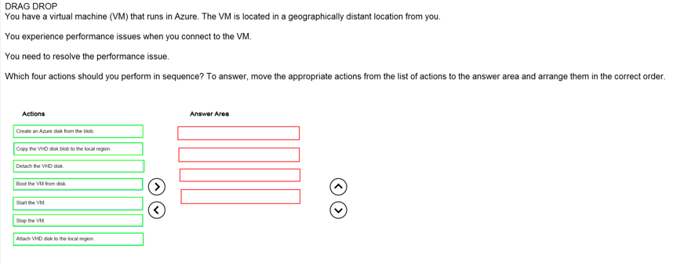
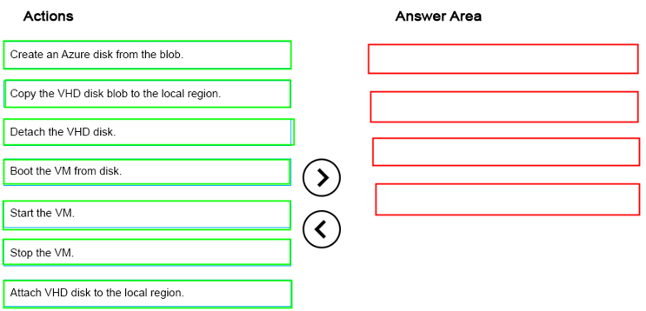
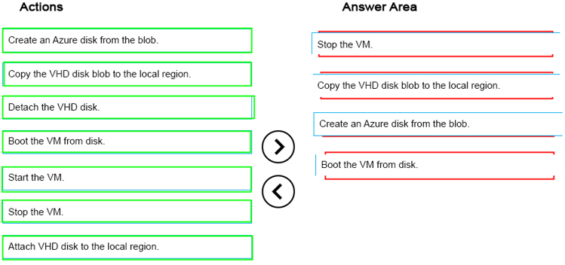
Ans =

Slide 3
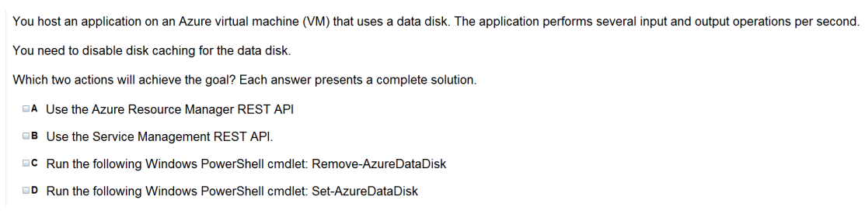
Ans = A & D

Slide 4
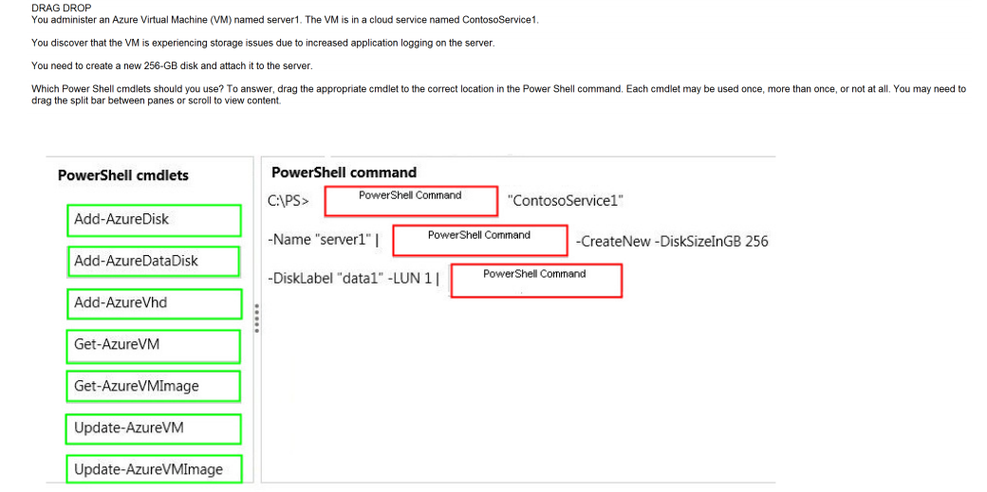
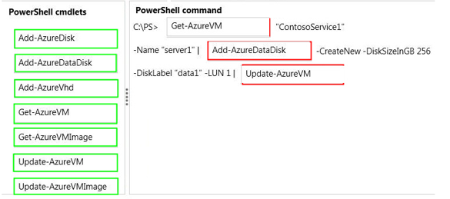
Ans =

Slide 5
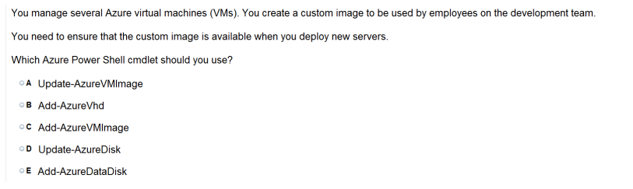
Ans = C

Slide 6
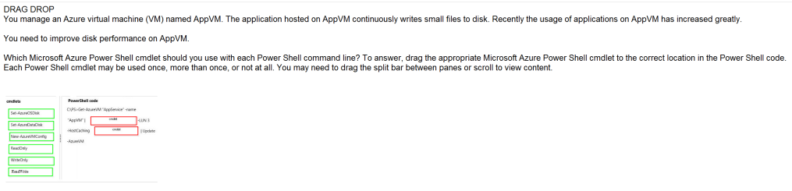
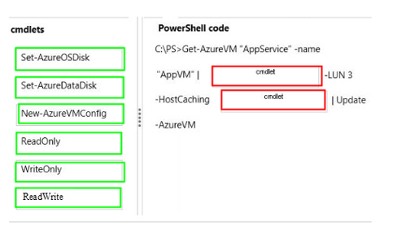
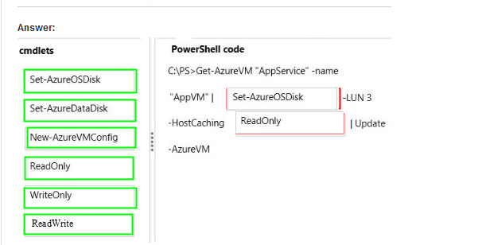
Ans =

Slide 7
Perform Configuration Management

Slide 8
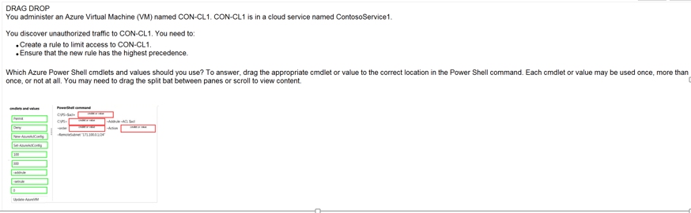
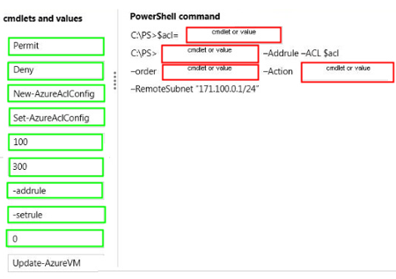
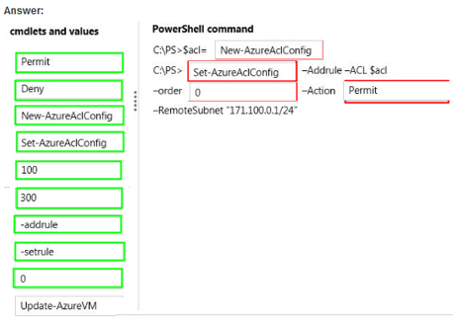
Ans =

Slide 9
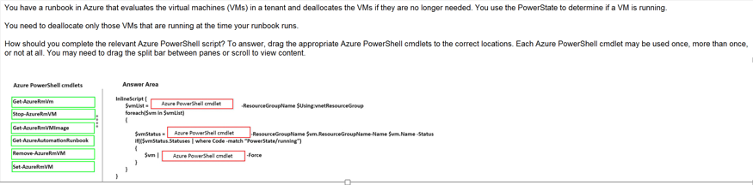
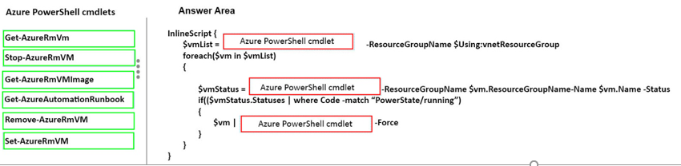
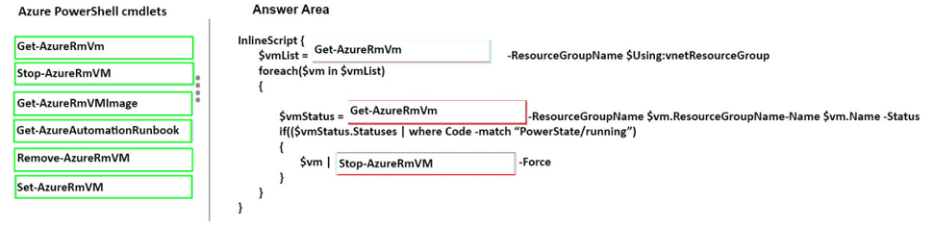
Ans =

Slide 10
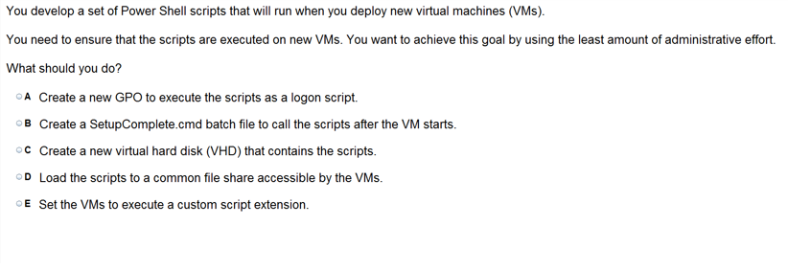
Ans = E

Slide 11
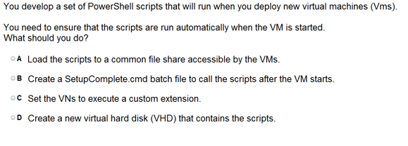
Ans =B

Slide 12
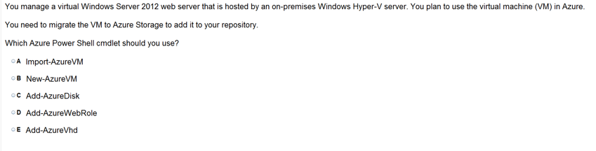
Ans =E

Slide 13
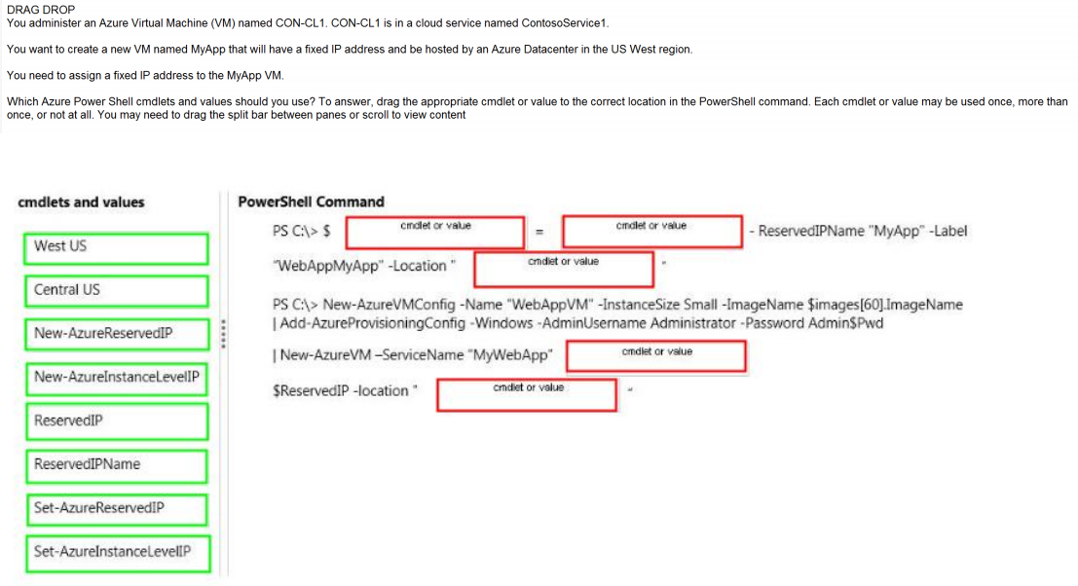
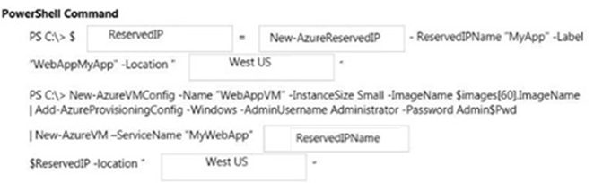
Ans =

Slide 14
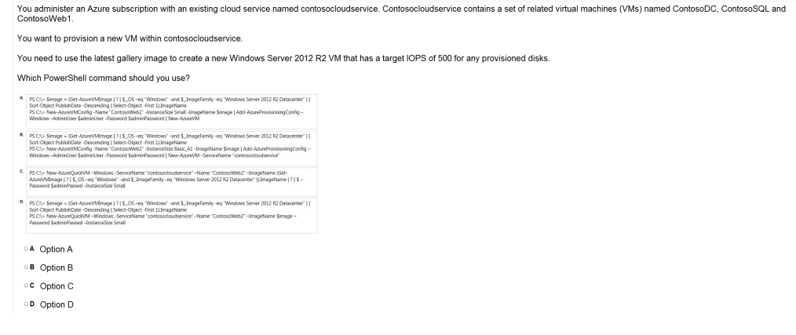
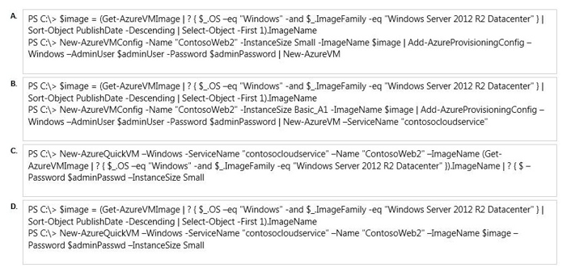
Ans = D New-AzureQuickVM uses for existing service.

Slide 15
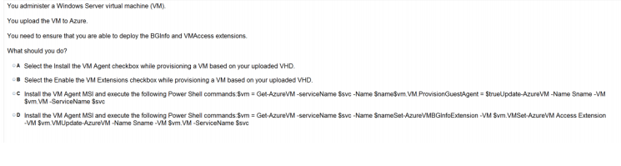
Ans – C What to Explain PowerShell

Slide 16
Deploy VM and Workload

Slide 17
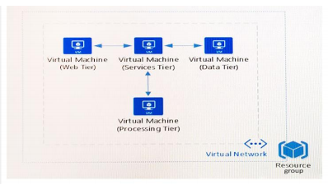
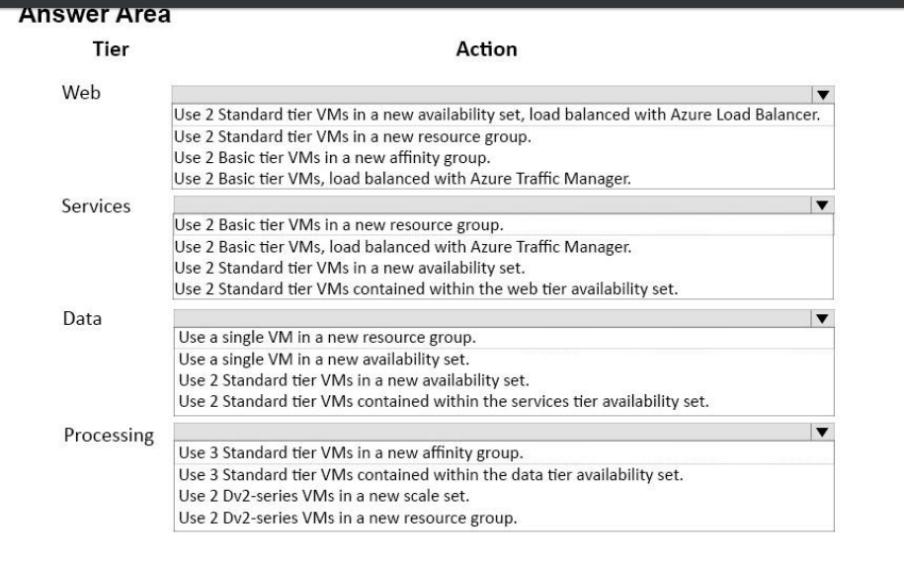

Slide 18
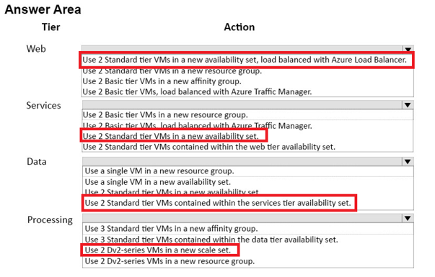

Slide 19
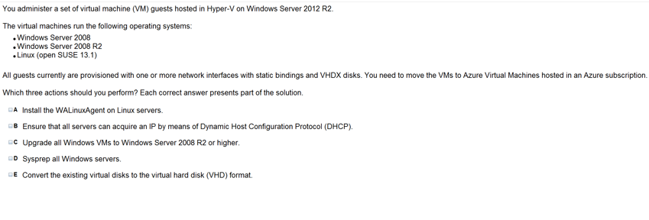
Ans = A & C & E

Slide 20
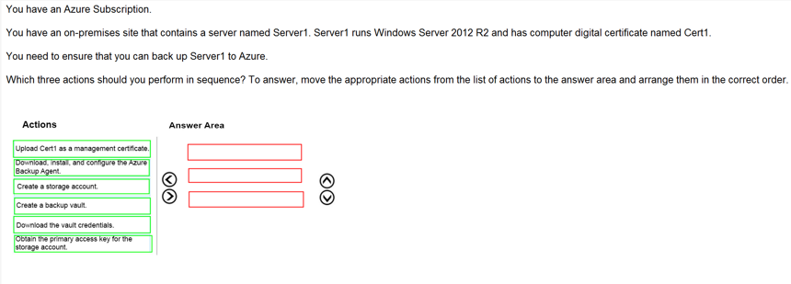
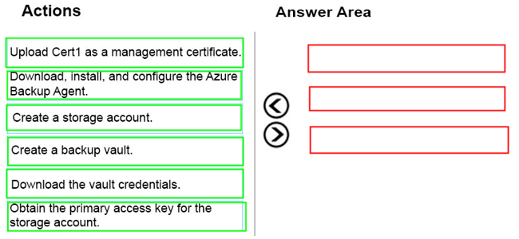
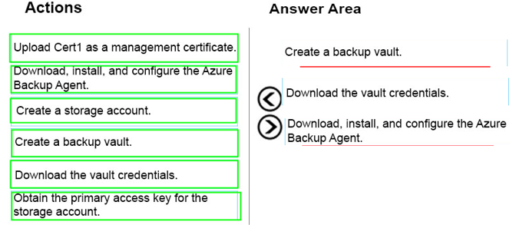
Ans =

Slide 21
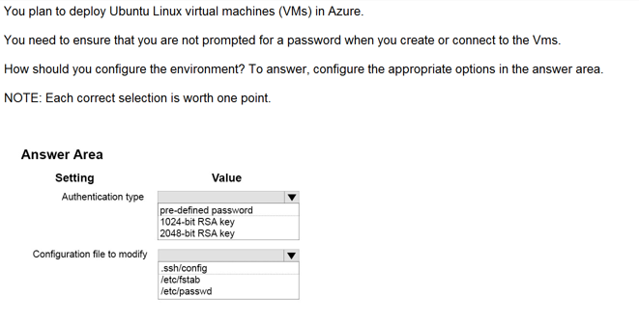
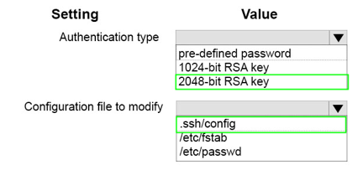
Ans =

Slide 22
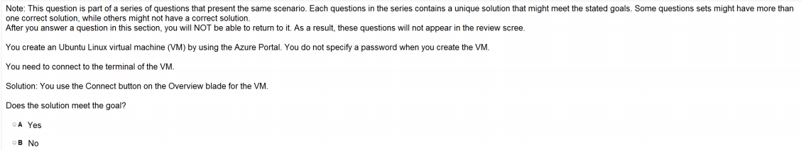
Ans = B

Slide 23
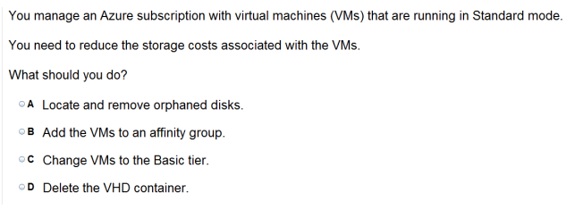
Ans = C

Slide 24
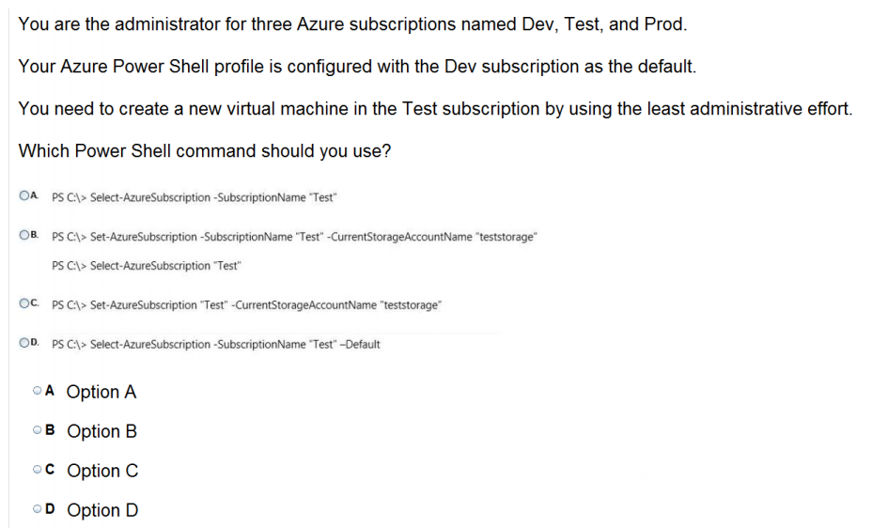
Ans = A

Slide 25
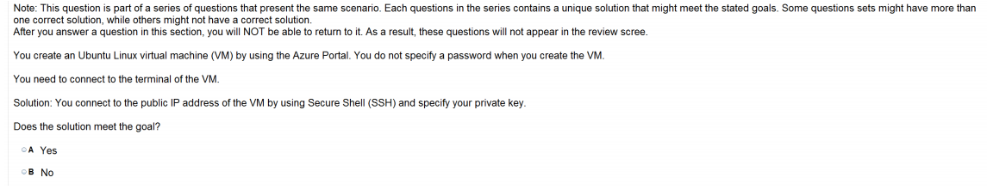
Ans = B Specify your Public Key – Ans YES Specify your Private Key – Nas NO

Slide 26
Configure VM Network

Slide 27
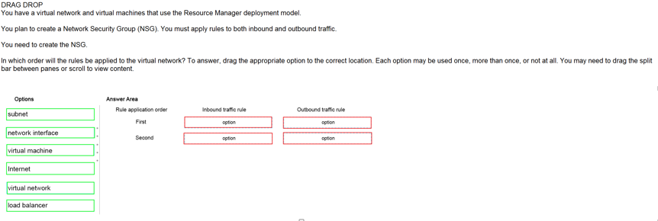
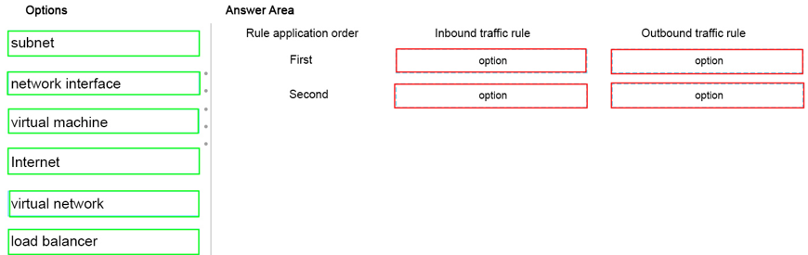
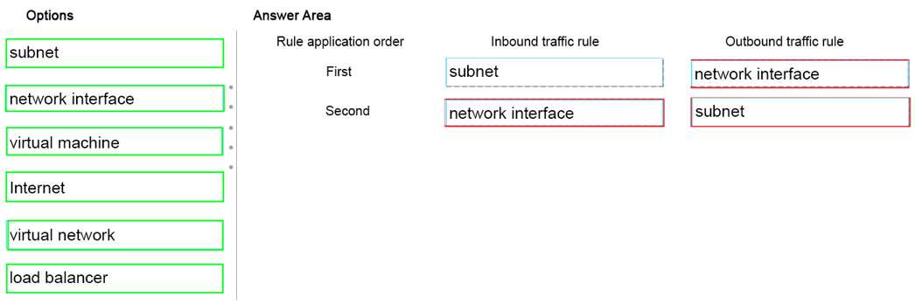
Ans =

Slide 28
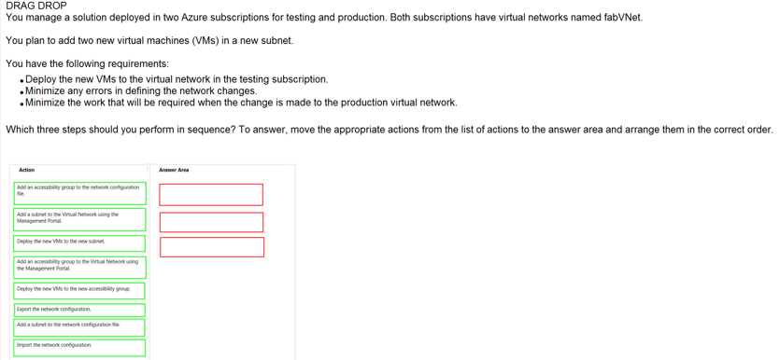
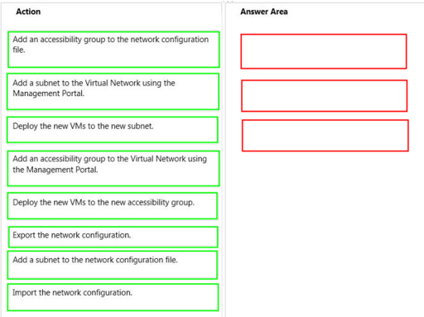
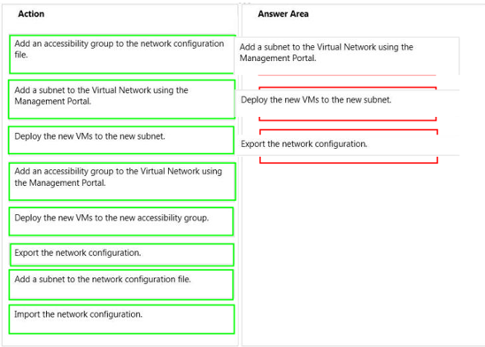
Ans =

Slide 29
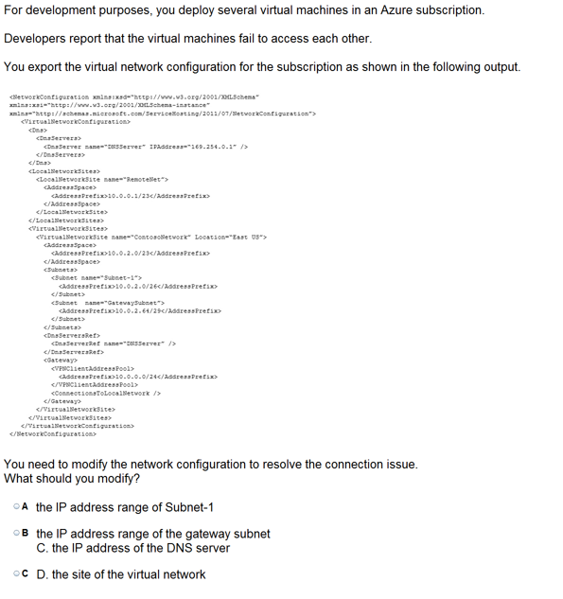
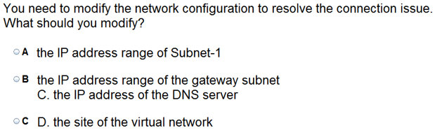
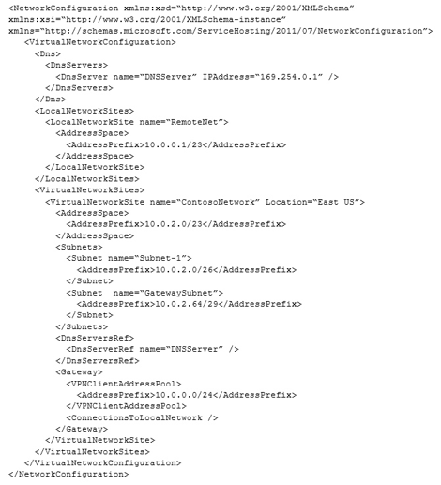
Ans = C

Slide 30
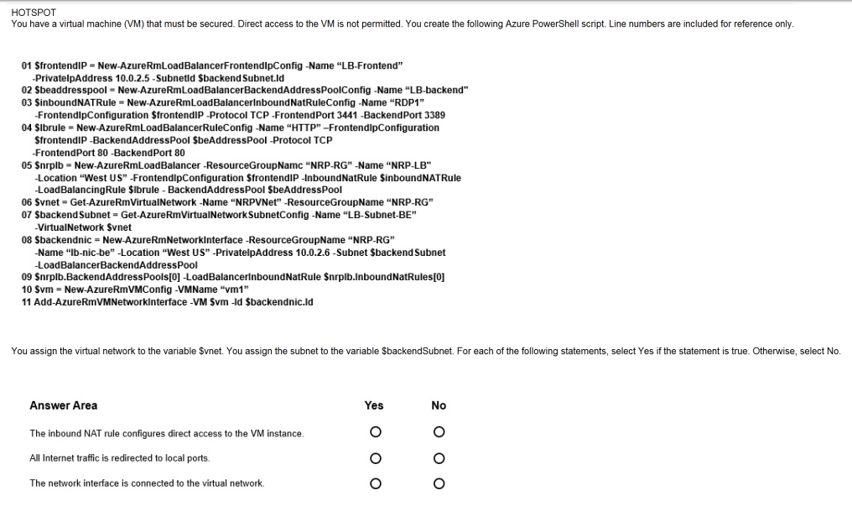
Ans =

Slide 31
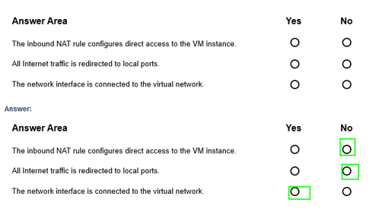

Slide 32
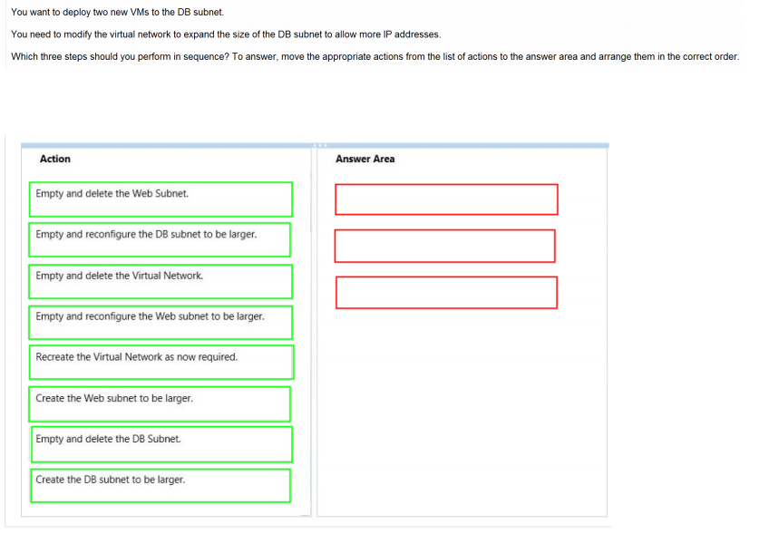
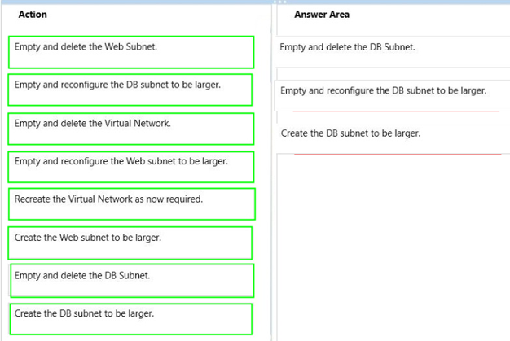
Ans =

Slide 33

Ans = E

Slide 34

Ans = B

Slide 35

Ans = C

Slide 36

Ans = C & D

Slide 37



Slide 38


Ans – Deny 0.0.0.0/0 - Means all other IP permit 145.34.67.82/32 – Only this IP permit

Slide 39

Ans = A

Slide 40

Ans – D

Slide 41


Ans =

Slide 42
Configure VM For resiliency

Slide 43

Ans = B & D

Slide 44

Ans = D

Slide 45

Ans = B & C

Slide 46

Ans = B Affinity Group not available in New Portal instead of that Regional Virtual Networks concept is their.

Slide 47



Ans =

Slide 48

Ans = D Availiability sets provide redundancy to your application. We recommend that you group two or more virtual machines in an availability set. This configuration ensures that during either a planned or unplanned maintenance event, at least one virtual machine will be available and meet the 99.95% Azure SLA.

Slide 49

Ans – B Fault Domain (FD) – A fault domain is a grouping of hardware (rack of resources like servers, power etc) in which web, worker and Virtual Machines are arranged. A Fault Domain is a generally said to be a single point of source of failure. In a simplest form, a computer by itself connected to a power outlet is a fault domain Update Domain (UD) – An update Domain on the other hand is an arrangement within the Racks so as to provide the Web or worker role instances with high availability by ensuring that only one of Instances of the roles will be down for update at one time.Role instances are allocated to an upgrade domain when the service is deployed.

Slide 50

Ans – C Demo Load Balancing – HTTP Endpoint

Slide 51
Monitor VM

Slide 52



Ans =

Slide 53

Ans = B

Slide 54

Ans =A & B

Slide 55


Ans = Show enable diagnostic option in azure portal VM

Slide 56

Ans = C

Slide 57
Design and Implement VM Storage

Slide 58

Ans =B

Slide 59


Ans = B

Slide 60

Ans = D

Slide 61

Ans =

